Slide 1
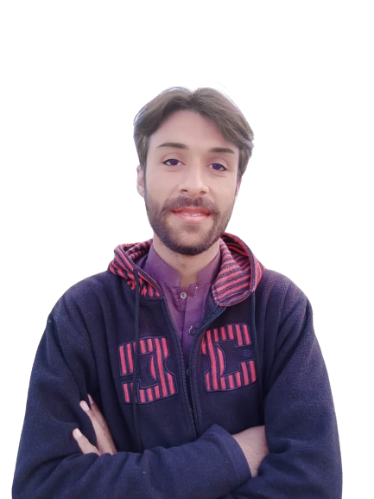
Complex Task Series
Problem Number 12

Slide 2
Problem Statement
Create a web application in python to create a super user and view the admin area

Slide 3
Algorithm
Step1: Install Python Django Library
Step2: Create Project
Step3: Create Application And Include In Settings.Py File In Django Project
Step4: Create a super user using a command:
python manage.py create superuser
Step5: View the admin area to get information
END

Slide 4
Assignment
Write A Python Program To Get A Integer Number From User To Convert Into Complex on Web

